Slide 1
JCRadio - Audio Streaming Status Report
Austin Chun

Slide 2
tl;dr
Audio capture on RPi works with UV4L
WebRTC seems like a good option for establishing audio connection
My toy-app works, but seems to not directly play well with Ruby on Rails project setup
I have no idea how to Ruby on Rails
Would really like WebSocket functionality w/ current project

Slide 3
Background - UV4L
UV4L (User space Video 4 Linux)
  Kernel level driver for capturing real-time audio (and video) from Linux devices (RPi)
  Closed source :/
  Documentation: link
Why I’m using it?
  Easy-ish to install/setup
  Simple config to access audio from RPi
  Simple config to send audio stream via WebRTC
  Once installed and setup, UV4L can spin up a server accepting WebRTC connections

Slide 4
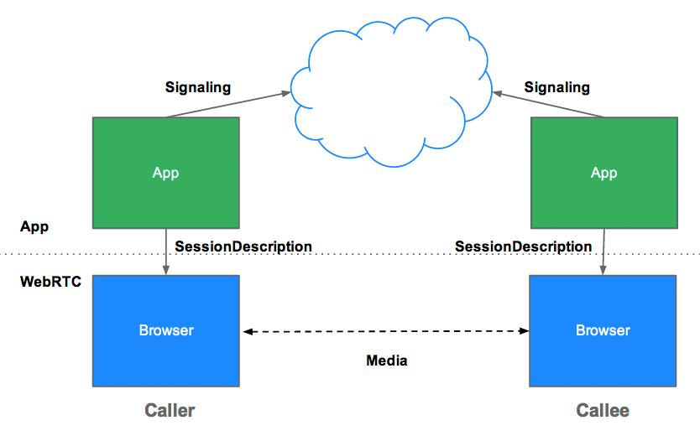
WebRTC (Real-Time Communication)
Open Source Google framework for Real-Time Communication
  Commonly used for video-chat web applications
  Plug-and-play with most modern browsers (Chrome, FireFox)
  JavaScript API
Why I’m using it?
  Simple API
  Seems popular
  Direct peer-to-peer connections

Slide 5
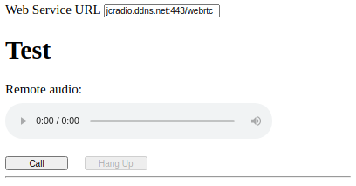
Current Status
Setup UV4L server, with WebRTC, talking to a simple front-end app
Music playing locally on RPi in loop
Client App establishes connection with UV4L server
Signalling handshake over WebSocket
Peer-to-peer connection established
Serves HTML/JavaScript (port 443) with ddns
RPi
(UV4L server)
Browser
(Chrome)
WebRTC Signalling (WebSocket)
WebRTC Connection

Slide 6
Current Status - Limitations
Only supports 1 peer-to-peer connection
  Solutions:
    Jitsi / Janus Gateway : Off-the-shelf conferencing solutions
      Seems like the standard path w/ UV4L
      But I couldn’t get it to work
    Have our App have 1 in port, and fan-out to multiple
UV4L is closed source, so difficult to modify
Serves HTML/JavaScript (port 443) with ddns
RPi
(UV4L server)
Browser
(Chrome)
WebRTC Signalling (WebSocket)
WebRTC Connection

Slide 7
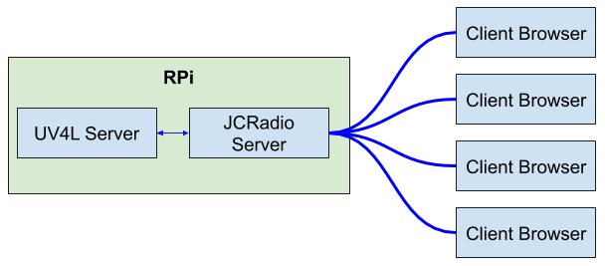
Custom Fanout
JCR Server connects to UV4L Server
  WebRTC connection
  UV4L pipes data to port 443
JCR Server copies Audio Stream to N user front ends

Slide 8
Custom Fanout - Setbacks
Current project is RESTful, no real-time back-and-forth
Adding WebSocket support is challenging (for me)
Apparently, UV4L ⇔ JCR won’t be the same as my toy example
  b/c this needs to be server-server, rather than the server-client JavaScript that I made

Slide 9
Custom Fanout - Next Steps
Add WebSocket functionality to Ruby on Rails
  Either Faye (Rails <5), or ActionCable (Rails 5)
UV4L ⇔ JCR Connection
  WebRTC Signalling
  WebRTC connection
JCR Fanout
  Copy one data stream to many
JCR ⇔ Client
  I think this is what my
  toy-example does
  already

